Slide 1
Meta Ads Marketing Performance Dashboard

Slide 2
Business Objective
The objective of this report is to track and analyze the performance of advertising campaigns across Facebook and Instagram. The dashboard provides visibility into reach, engagement, conversions, and budget utilization to support data-driven marketing decisions.
This enables the marketing team to:
Identify the most effective platform (Facebook vs Instagram)
Monitor campaign ROI and optimize budget allocation
Understand audience engagement and conversion behavior

Slide 3
Scope of the Report:
Platforms: Facebook & Instagram (Meta Ads)
Metrics Covered: Impressions, Clicks, Engagements, CTR, Engagement Rate %, Purchases, Conversion Rate %, Purchase Rate %, Budget
Analysis Levels: Campaign, Ad Type, Platform, Audience Demographics, Time
Time Intelligence: Hourly, Weekly, Calendar-based performance analysis
Interactivity: Platform and metric slicers for dynamic analysis

Slide 4
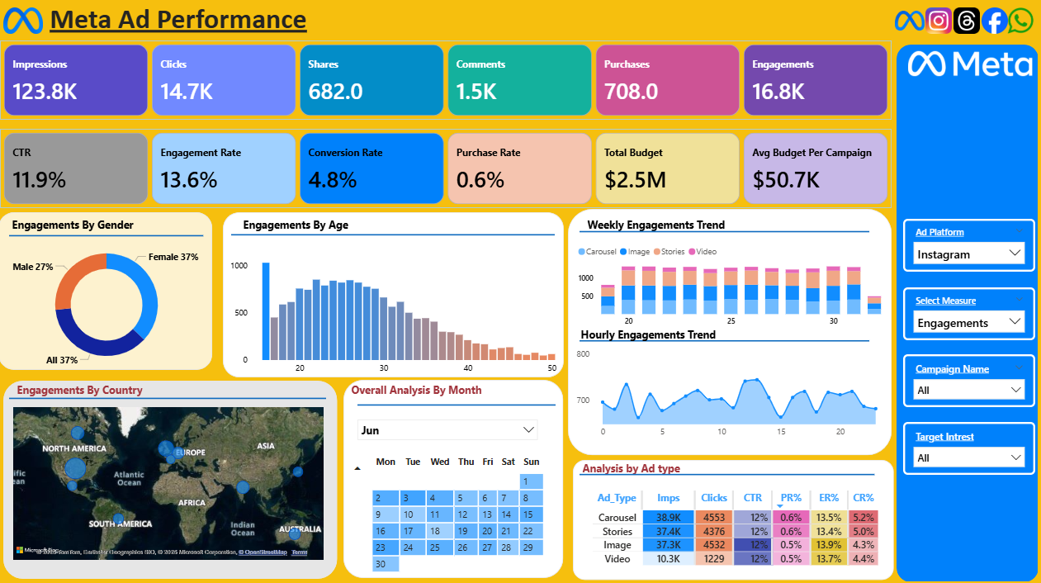
Overview of dashboard

Slide 5
KPI Performance summary
Total Impressions: 339K Facebook contributes 216K (≈64%), while Instagram delivers 123K (≈36%), making Facebook the primary reach driver.
Total Clicks: 40K Facebook accounts for ~25K clicks, indicating stronger traffic generation compared to Instagram.
Engagement Breakdown:
Shares: 2K (Facebook: 1.3K)
Comments: 4K (Facebook: 2.6K) Facebook leads in deeper user interactions.

Slide 6
KPI Performance summary
Click-Through Rate (CTR): 11.8% overall, with Facebook performing at par with the overall CTR.
Engagement & Conversion Rates:
Overall Engagement Rate: 5.1%
Facebook Engagement Rate: 13.6% (significantly higher)
Facebook Conversion Rate: 5.2%, indicating stronger post-click performance.
Budget Utilization:
Total Budget: ₹2.5M
Highest Budget Campaign: ₹50K, suggesting spend is distributed across multiple campaigns rather than concentrated.

Slide 7
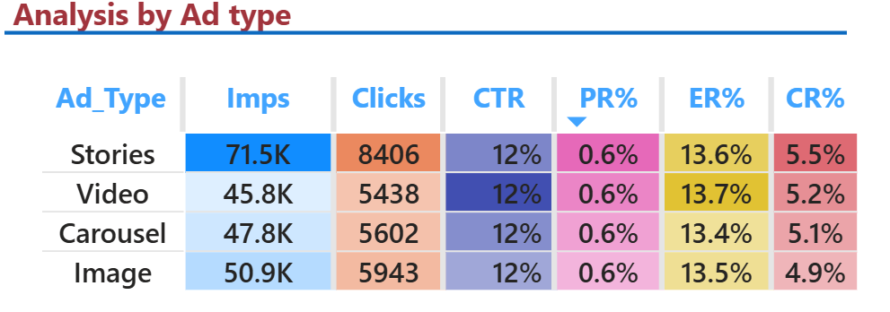
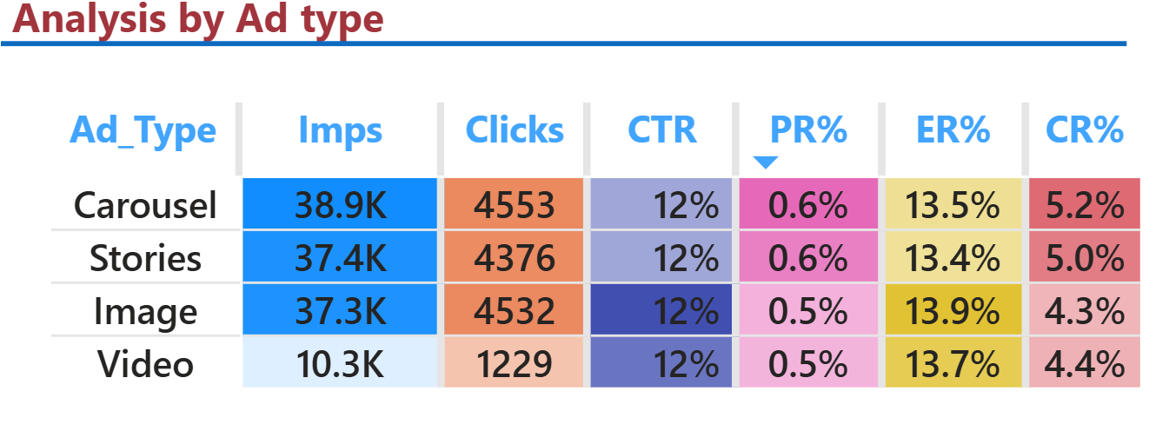
Facebook VS Instagram Ad Type Performance
Impressions & Clicks: Facebook Stories are the top-performing format (~70K impressions), while Instagram Carousel leads on Instagram (~39K impressions).
User Interaction Pattern: Stories drive higher volume on Facebook; Carousel formats generate stronger engagement on Instagram.
Efficiency Metrics: CTR, Engagement Rate, Purchase Rate, and Conversion Rate remain consistent across platforms, indicating similar traffic quality.
Overall Takeaway: Optimize creatives by platform — use Stories for Facebook and Carousel for Instagram to maximize reach and engagement.
Facebook
Instagram

Slide 8
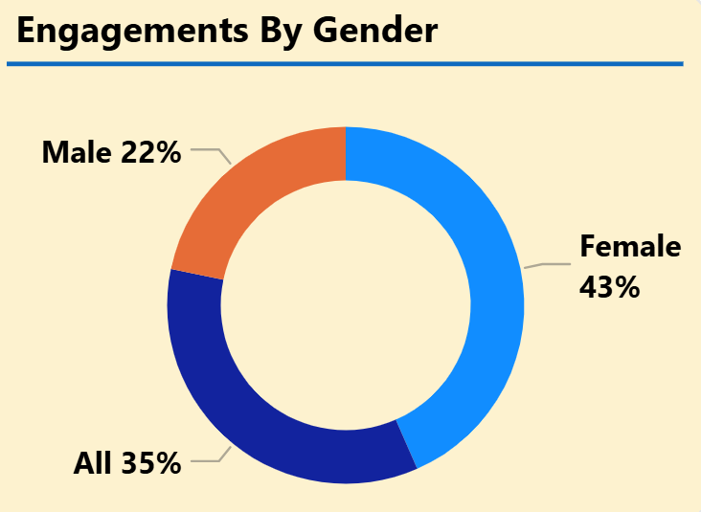
Gender-Based Performance Insights
Female audience drives higher engagement, contributing ~40% across key measures
(engagements, interactions, likes, and shares) on both Facebook and Instagram, compared to ~20% from male users.
Conversions skew strongly toward female users:
Female purchases: 817
Male purchases: 474
Female conversions are nearly 2× higher, indicating stronger purchase intent.
The trend is consistent across platforms, suggesting gender-based behavior rather than platform bias.

Slide 9
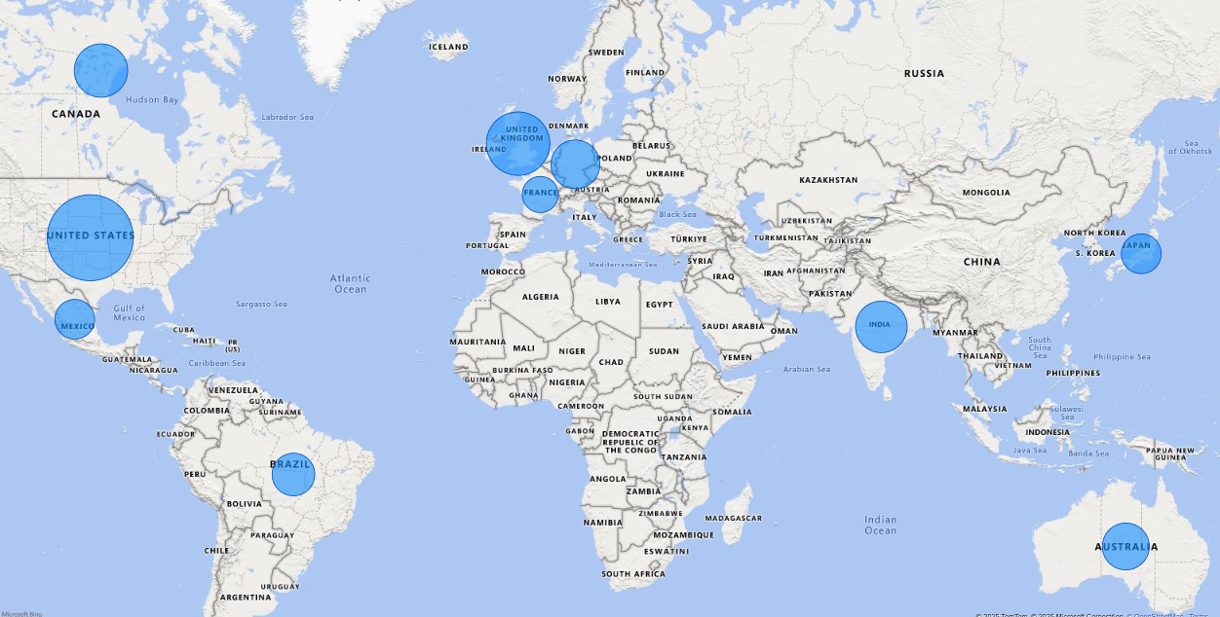
Country Performance Insights
USA leads in scale and outcomes, with the highest impressions (36K), clicks (4K), and strongest conversion rate (5.7%), making it the top-performing market overall.
UK and India show high engagement efficiency:
India: Highest CTR (12.5%) and strong engagement (13.8%), but relatively lower conversion (4%).
UK: Balanced performance with solid CTR (12%) and conversion rate (4.6%).
Canada delivers steady but moderate results, with consistent engagement (13.5%) but lower scale compared to the USA.
France, despite low volume, shows strong efficiency, with a 5.1% conversion rate, indicating high-quality traffic in a smaller market.
Overall Takeaway
Scale markets: USA
Optimize & nurture: India and UK
Test & grow: France
Maintain: Canada

Slide 10
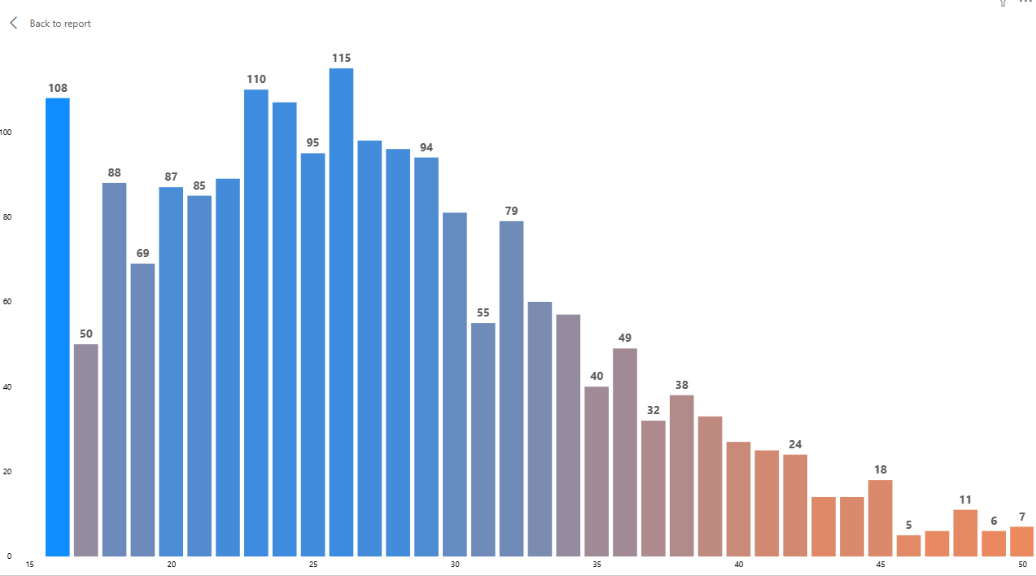
Age Group Performance Insights
Purchases are highest in the 20–30 age group, making it the primary revenue-driving segment across Meta platforms.
Impressions and engagements peak among the 19–25 age group, indicating strong awareness and interaction from younger users.
Performance drops significantly after 35+, with low impressions, engagement, and conversions across all metrics.
Primary Audience Identified: Young adults (19–30 years), with early 20s showing the strongest overall performance

Slide 11
Final Insights & Recommendations
Strong top-of-funnel performance High CTR and Engagement Rate indicate strong awareness, but purchase funnel efficiency is low, requiring improved conversion strategies.
Core target audience identified Best-performing segment: Females aged 18–30, with strongest results in India and Brazil.
Winning ad formats Video ads perform best, followed by Stories, then Carousel/Image formats.
Optimal ad timing User engagement and conversions peak during afternoon and evening hours.
Budget optimization opportunity Reallocate spend toward high-performing geographies, age groups, and ad formats to improve ROI.
Recommended actions Optimize landing pages, strengthen offers, and scale retargeting campaigns to increase purchase rates.

Slide 12
Thank you
Karthik KVL Data Analyst – BI & CRM | 9*05*3*6** karthikdnd@gmail.com

